Slide 1
AGENDA
HTML + CSS
JavaScript + NodeJS
ECMScript 6
Functioneel programmeren

Slide 2

Recommended Site
https://www.freecodecamp.org/news/a-practical-guide-to-learning-front-end-development-for-beginners-da6516505e41/

Slide 3

HTML + CSS

Slide 4
Three Layers of the Web

Slide 5
Keep all of these 3 layers separate !
JavaScript in a .js-file
CSS styling in a .css-file
HTML in a .html-file

Slide 6
HTML + CSS
See:
https://www.w3schools.com/html
And:
https://www.internetingishard.com/html-and-css/basic-web-pages/

Slide 7
JavaScript - language

Slide 8
Requirements
Must have Node installed !
Must have Chrome installed
Use Visual Studio IDE

Slide 9
Agenda JavaScript
What is JavaScript
What is ECMAScript
JavaScript - the Basics

Slide 10
What is JavaScript
Go to:
w3schools.com

Slide 11
JavaScript
Object-oriented
Scripting language
Depends on Browser or Node to execute
Used to make webpages interactive.

Slide 12
JavaScript
Client-side
en
Server-side

Slide 13
Client-side
JavaScript can be executed by browsers
The browser extends JavaScript to:
Manipulate DOM (Data Object Model)
Interact with services from the browser

Slide 14
Server-side JavaScript
Executed by Node
Extended with objects to:
Interact with IO
Interact with Sockets

Slide 15

HTML-DOM – tree of objects
Notes:
With the object model, JavaScript gets all the power it needs to create dynamic HTML:
JavaScript can change all the HTML elements in the page
JavaScript can change all the HTML attributes in the page
JavaScript can change all the CSS styles in the page
JavaScript can remove existing HTML elements and attributes
JavaScript can add new HTML elements and attributes
JavaScript can react to all existing HTML events in the page
JavaScript can create new HTML events in the page

Slide 16
The HTML DOM is a Programming Interface
for how to
get, change, add
or delete HTML elements

Slide 17
https://www.w3schools.com/js/js_htmldom.asp

Slide 18
ECMAScript

Slide 19
ECMAScript
Netscape asked Ecma International to create JavaScript specification
Started in 1996, first release in 1997
Notes:
ECMA = European Computer Manufacturers Association

Slide 20
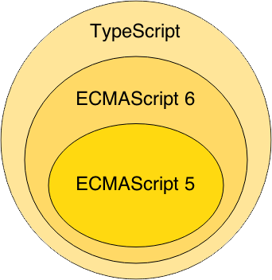

Slide 21
JavaScript
The Basics

Slide 22
Starting point:
MDN Web docs
https://developer.mozilla.org/

Slide 23
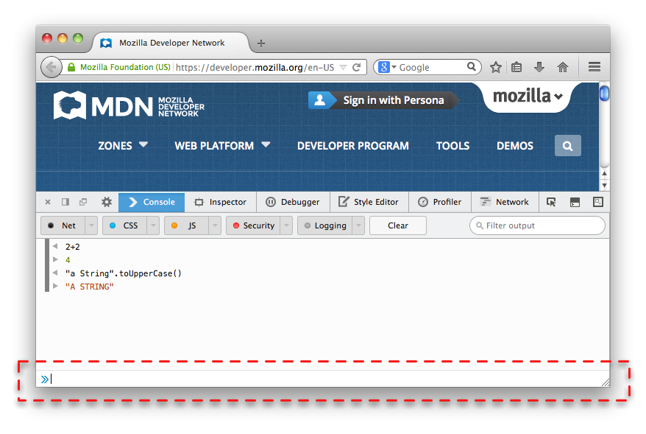
Browser Console
Internet Explorer F12
Firefox Ctrl + Shift + J
Chrome - View > Developer > JavaScript Console
Notes:
Nearly every browser can run JavaScript and most modern browsers now include a JavaScript console that can be used to run snippets of JavaScript code.

Slide 24
Your First JavaScript Program
Type the following in your Browser Console:
console.log("Hello World!");

Slide 25
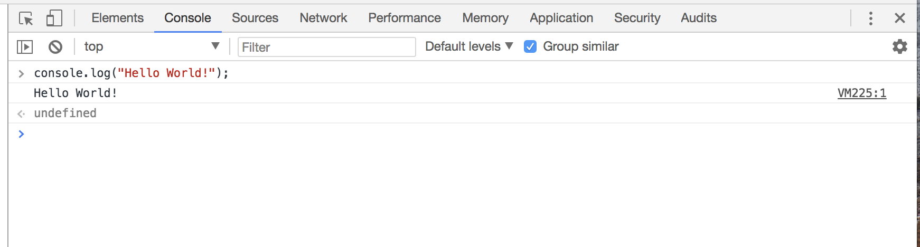

Slide 26
Three Layers of the Web

Slide 27
Keep all of these 3 layers separate !
JavaScript in a .js-file
CSS styling in a .css-file
HTML in a .html-file

Slide 28
Hello world example
https://plnkr.co/edit/?p=preview&preview

Slide 29
Important Guides JS
https://javascript.info/
https://developer.mozilla.org/nl/

Slide 30
Tutorial
https://developer.mozilla.org/en-US/docs/Learn/Getting_started_with_the_web/JavaScript_basics

Slide 31
https://mdn.github.io/beginner-html-site-scripted/
DEMO Final solution !!!

Slide 32
First step
download
https://github.com/mdn/beginner-html-site-styled/archive/gh-pages.zip
Notes:
Calculator: http://embed.plnkr.co/YB9vnC/

Slide 33
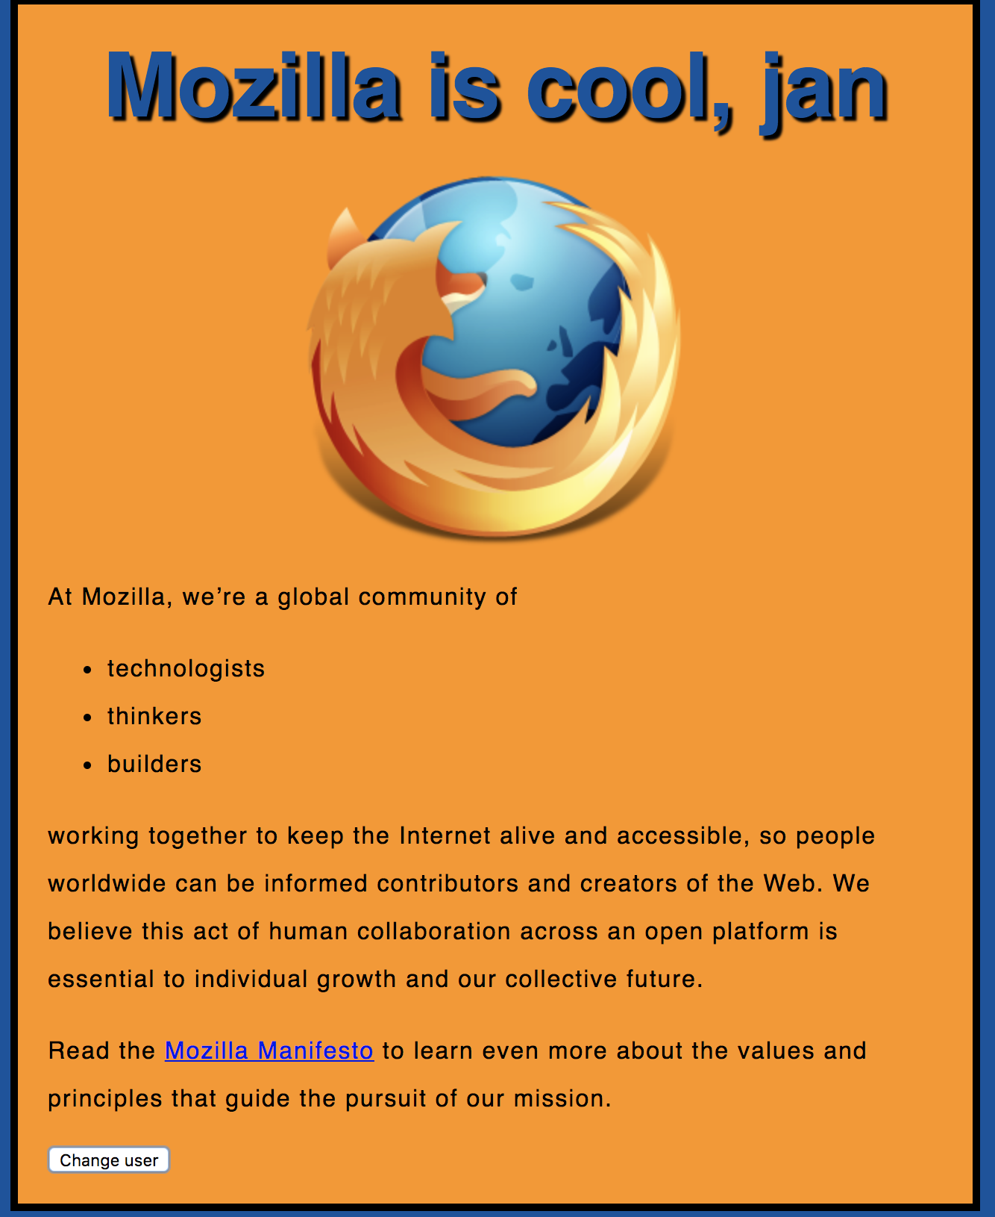
Notes:
https://mdn.github.io/beginner-html-site-scripted/

Slide 34
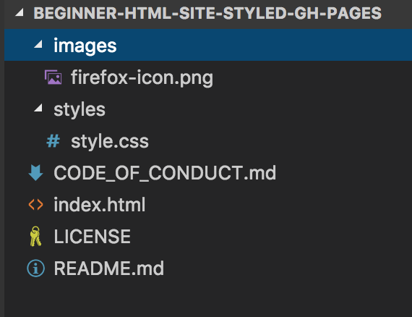

Slide 35
<!DOCTYPE html>
<html>
<head>
</head>
<body>
</body>
</html>
index.html

Slide 36
<!DOCTYPE html>
<html>
<head>
<meta charset="utf-8">
<title>My test page</title>
<link href="styles/style.css" rel="stylesheet" type="text/css">
</head>
<body>
<h1>Hello World!</h1>
<img src="images/firefox-icon.png">
</body>
</html>

Slide 37
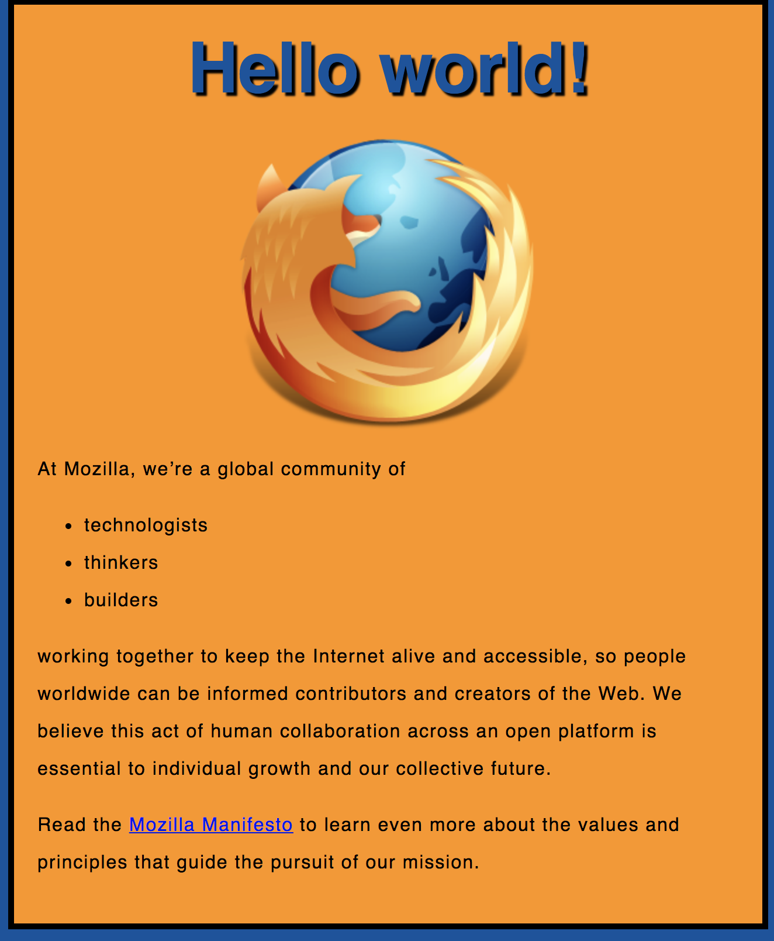
Exercise 1

Slide 38
Exercise 1
Create a new file called main.js
Save it in your scripts folder.

Slide 39
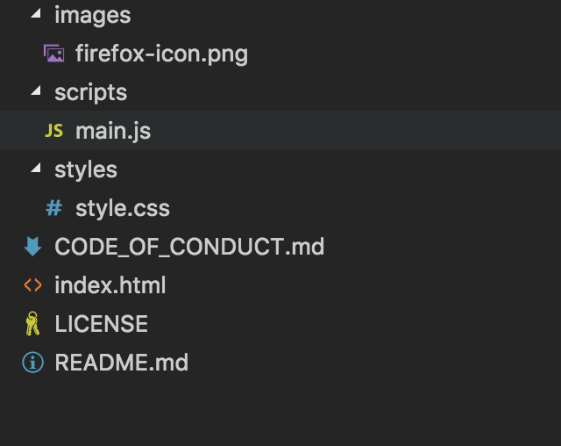

Slide 40
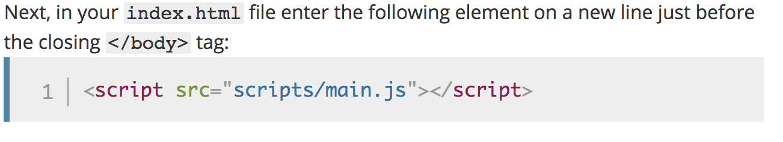
Notes:
<script src="scripts/main.js"></script>

Slide 41
<!DOCTYPE html>
<html>
<head>
<meta charset="utf-8">
<title>My test page</title>
<link href="styles/style.css" rel="stylesheet" type="text/css">
</head>
<body>
<h1>Hello World!</h1>
<img src="images/firefox-icon.png" alt="The Firefox logo: a flaming fox.">
<script src="scripts/main.js"></script>
</body>
</html>
Notes:
Note: The reason we've put the <script> element near the bottom of the HTML file is that HTML is loaded by the browser in the order it appears in the file. If the JavaScript is loaded first and it is supposed to affect the HTML below it, it might not work, as the JavaScript would be loaded before the HTML it is supposed to work on. Therefore, putting JavaScript near the bottom of the HTML page is often the best strategy.

Slide 42
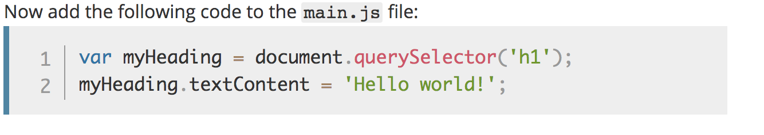
Manipulate HTML/DOM
Notes:
Note: Both of the features you used above are parts of the Document Object Model (DOM) API, which allows you to manipulate documents.
let myHeading = document.querySelector('h1');
myHeading.textContent = 'Hello world!';

Slide 44
Variables

Slide 45
Variables
var myVar = "foobar";

Slide 46
Variables
var a, b, c;
var a = 3;
var d = 10, e = 10;
f = 22;
var pi = 3.14159;
var s = 'a', t = "t";

Slide 47
Identifiers
Must start with either “$”, “_” or a letter
Subsequent letters can be “$”, “_”, letter, numbers
var 1abc = 3; // Invalid
var $123 = 3; // Valid
Notes:
Identifier = variabelenaam.

Slide 48
Types
“Primitive” value types:
Number (floating point)
String
Boolean
null
undefined
Notes:
null = NIL
undefined= niet geinitializeerd.

Slide 49
Built-in values
true & false
null
undefined
NaN (=Not A Number)
Infinity

Slide 50
Conditionals

Slide 51
Conditionals
if (expression1) {
//Executes when expression1 is truthy
} else if (expression2) {
//Executes when expression2 is truthy
} else {
//Executes when none of the above conditions are truthy
}

Slide 52
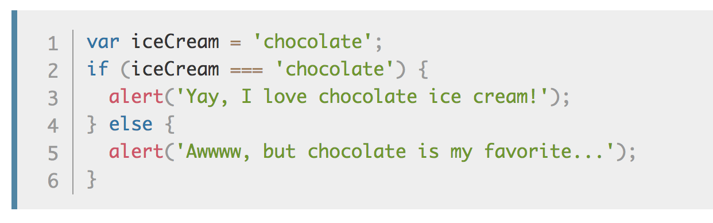
Conditionals

Slide 53
Truthy Falsy
Falsy values:
false, null, undefined, 0, ‘’, NaN
Truthy values:
Everything else

Slide 54
if (null) { // false
} else if (0) { // false
} else if ('') { // false
} else if (1) { // true
}

Slide 55
== vs ===
== performs type coercion
tries to match types for comparison
=== does NOT perform type coercion
will fail if type is different
Notes:
== Coercion: cast gelijk de datatypes.
===

Slide 56
Conditionals

Slide 57
Example
"" === 0 // false
"" == 0 // true
'0' == 0 // true
false == '0' // true
4 != '4' // false
4 !== '4' // true
Try to use ===, !==
instead of ==, !=

Slide 58
Infix operators same as Java
var x = 4;
if (x > 3 && x < 6) {
} else if (x > 3 || x === 2) {
}

Slide 59
Functions

Slide 60
Functions
Functions are objects
Can be created on their own (anonymous)
function foo() {
alert(“HOI”);
}
Can assigned to a variable
var x = function() {}

Slide 61
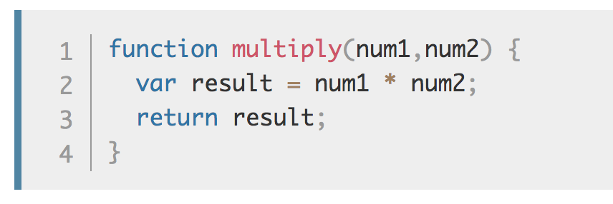
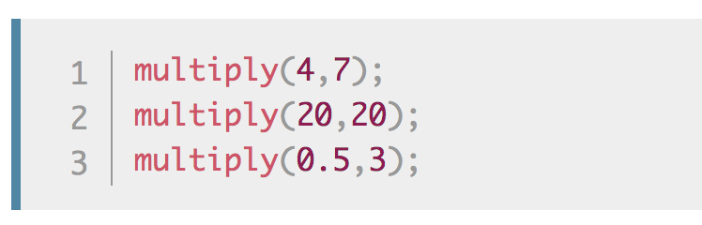
Make your own functions
Notes:
Note: The return statement tells the browser to return the result variable out of the function so it is available to use.
This is necessary because variables defined inside functions are only available inside those functions.
This is called variable scoping.

Slide 62
Events
Examples when Events are executed:
clicked on a button. onClick-event()
clicked on a page
pressed on enter-key

Slide 63
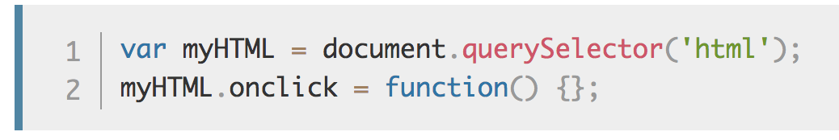
onclick Event

Slide 64
Use “let” or “const” instead of “var”
In modern JavaScript we have 3 ways to declare a variable and assign it a value:
var
let a= 5;
const STATIC1=“ik ben static”
Notes:
See: https://dev.to/mrmario/let-var-const-write-clean-and-safe-code-37hh
https://flaviocopes.com/javascript-difference-let-var/
Var function scoping. Var is a bit more weird, as it has function scoping, which means that variables declared using var are scoped to the nearest function.
Let is block scoping is safer. Niet bekend in de global scope

Slide 65
Let is block scoped
https://www.w3schools.com/js/js_let.asp
https://developer.mozilla.org/en-US/docs/Web/JavaScript/Reference/Statements/let

Slide 66
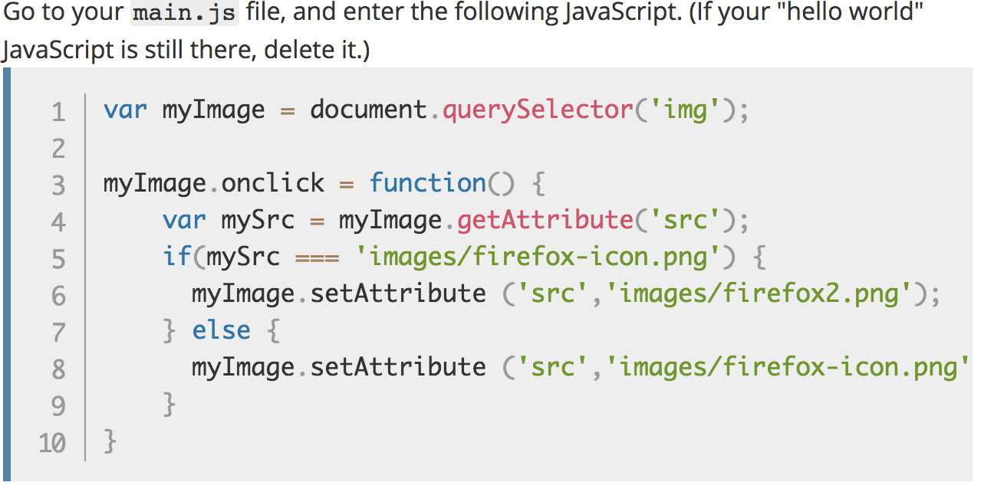
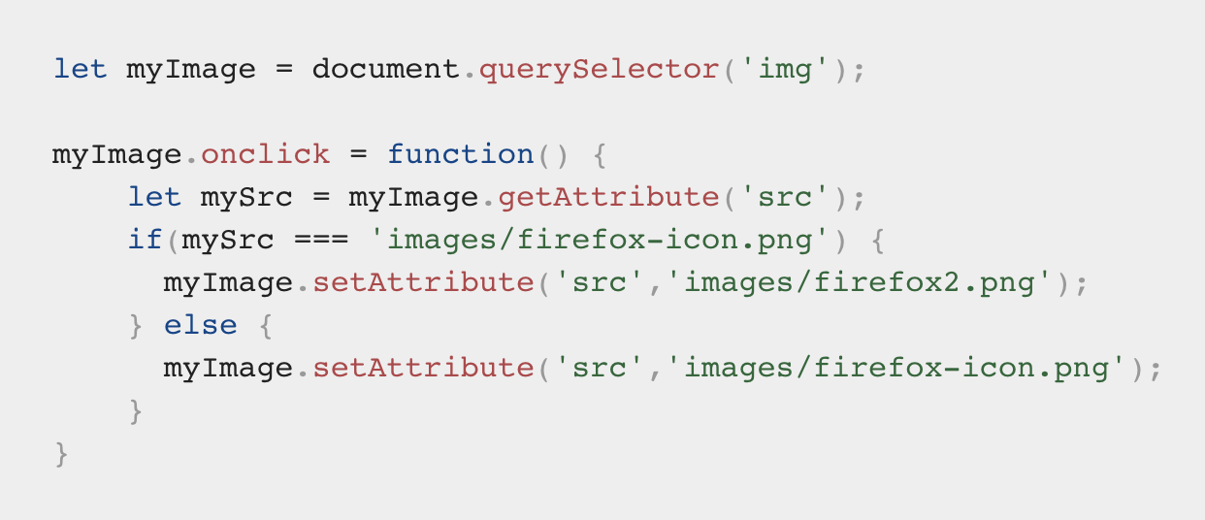
Exercise 2
Notes:
You store a reference to your <img> element in the myImage variable. Next, you make this variable's onclick event handler property equal to a function with no name (an "anonymous" function). Now, every time this element is clicked:
let myImage = document.querySelector('img');
myImage.onclick = function() {
let mySrc = myImage.getAttribute('src’);
if(mySrc === 'images/firefox-icon.png') {
myImage.setAttribute ('src','images/firefox2.png’);
} else {
myImage.setAttribute ('src','images/firefox-icon.png’);
}
}

Slide 67
Exercise 3
Adding a personalized welcome message

Slide 68
Notes:
https://mdn.github.io/beginner-html-site-scripted/

Slide 69
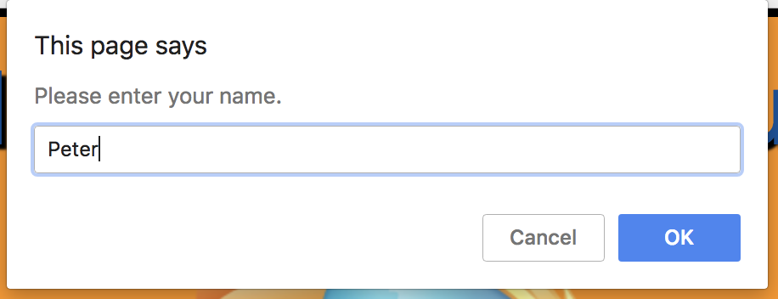

Slide 70
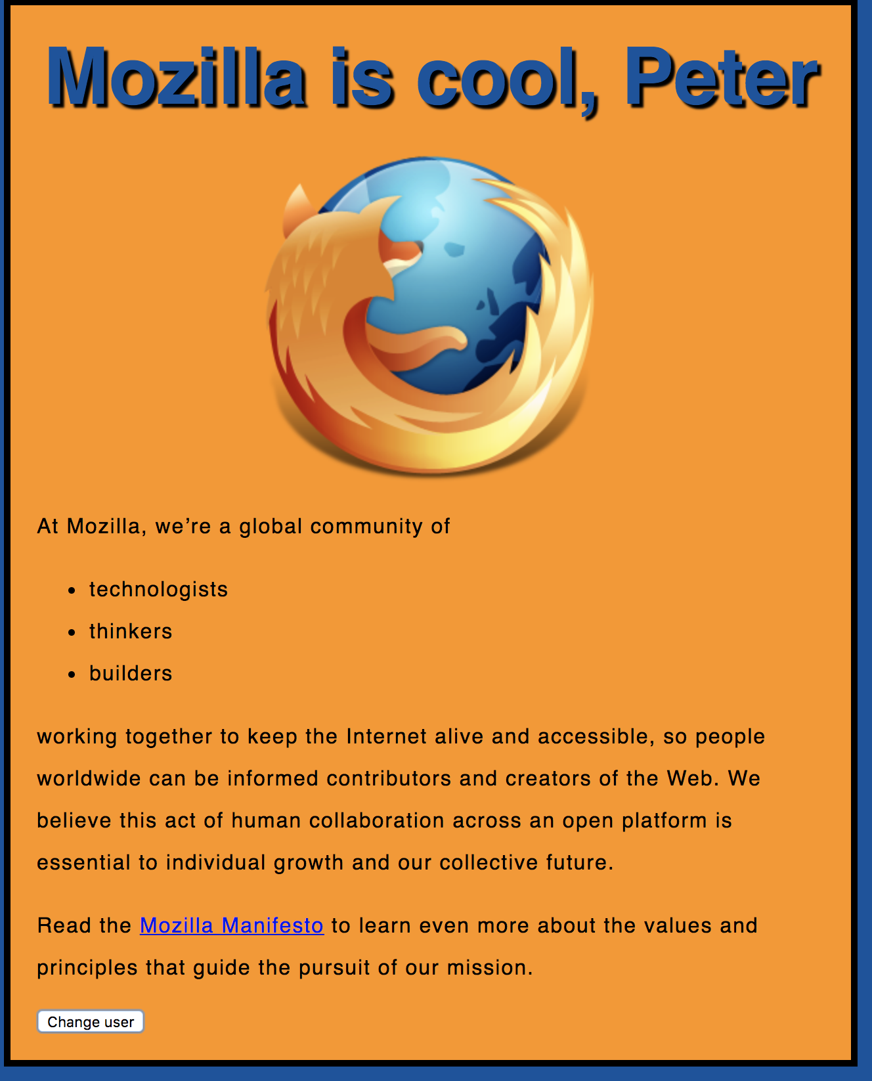

Slide 71
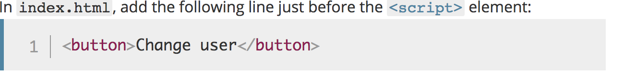

Slide 72
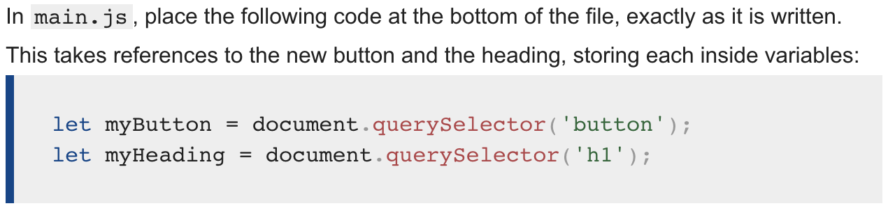
Notes:
let myButton = document.querySelector('button’);
let myHeading = document.querySelector('h1');

Slide 73
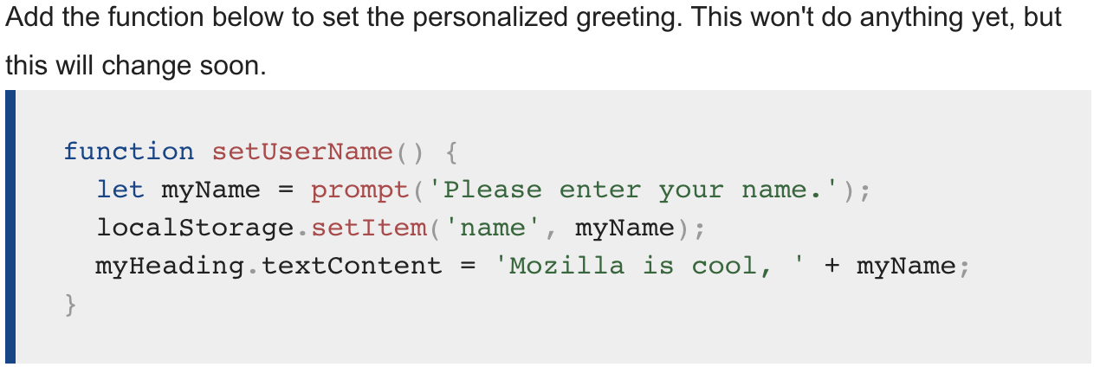
Notes:
function setUserName() {
let myName = prompt('Please enter your name.');
localStorage.setItem('name', myName);
myHeading.innerHTML = 'Mozilla is cool, ' + myName;
}

Slide 74
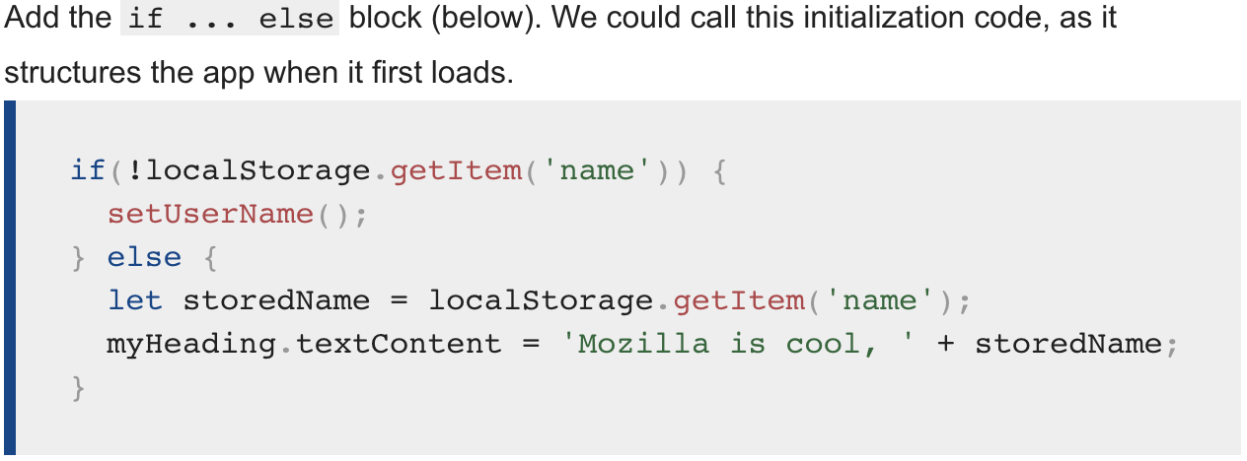
Notes:
if(!localStorage.getItem('name')) {
setUserName();
} else {
let storedName = localStorage.getItem('name');
myHeading.innerHTML = 'Mozilla is cool, ' + storedName;
}

Slide 75
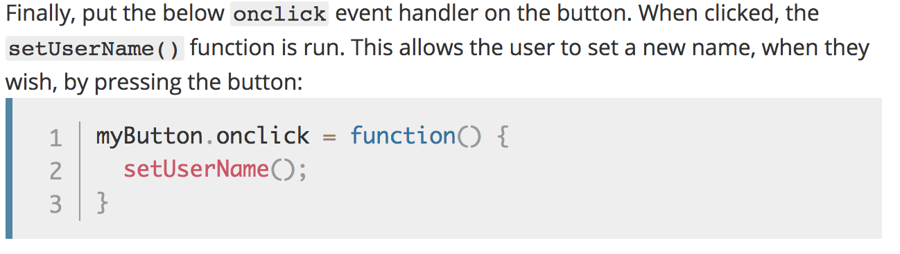
Notes:
myButton.onclick = function() {
setUserName();
}

Slide 76
Solution
https://github.com/mdn/beginner-html-site-scripted

Slide 77
Iterators/ Loops

Slide 78
Iterators
while (expression) { .. }
for (let i=0; i < cars.lenght; i++) { .. }
for (variable of object) { .. }
for (variable in object) { .. }

Slide 79
for of
The for of - statement
loops through the values of an iterable object.

Slide 80
for of
const cars = ["BMW", "Volvo", "Mini"];
let text = "";
for (let x of cars) {
text += x + "<br>";
} // BMW Volvo Mini

Slide 81
for in
The for in - statement
loops through the properties of an Object:

Slide 82
const person = {fname:"John", lname:"Doe", age:25};
let txt = "";
for (let x in person) {
txt += person[x] + " ";
} // John Doe 25

Slide 83
let list = [4, 5, 6];
for (const in list) { console.log(i); // "0", "1", "2" }
for (const i of list) { console.log(i); // "4", "5", "6" }

Slide 84
Arrays

Slide 85
Arrays
let beers = ['Heineken', 'Amstel', 'Jupiler’];
let cars = new Array("Saab", "Volvo", "BMW");
console.log(beers.length); // output is 3
let x = beers[0]; // x => 'Heineken'

Slide 86
Arrays
let beers = ['Heineken', 'Amstel', 'Jupiler'];
beers[5] = 'Palm';
console.log(beers.length); // output is 6 (!)
console.log(beers[3]); // output is undefined (!)
beers = [ , 'Heineken', , 'Amstel'];
console.log(beers.length); // output is 4 (!)

Slide 87
Objects

Slide 88
Objects
let car = new Object();
car.make = 'Ford';
car.model = 'Mustang';
car.year = 1969;

Slide 89
Associative Array /
Dictionary
let car = new Object();
car['make'] = 'Ford';
car['model'] = 'Mustang';
car['year'] = 1969;

Slide 90
JSON
let car = {
make: 'Ford’,
model: 'Mustang’,
year: 1969
};

Slide 91
JSON

Slide 92
JSON
JavaScript Object Notation
A common use of JSON is:
to exchange data to/from a web server.

Slide 93
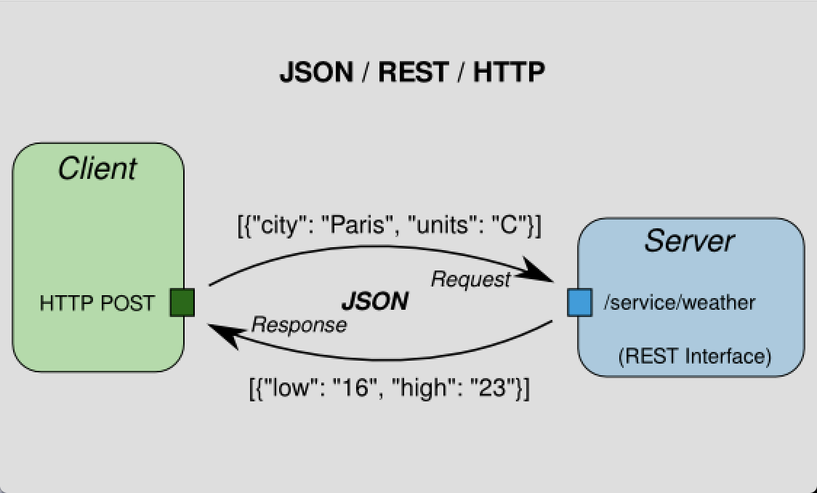

Slide 94
Valid JSON
let obj = {
"name":"John",
"age":30,
"city":"New York”
};

Slide 95
JSON
For parsing use:
var json = JSON.parse('{..}')
var jsonString = JSON.stringify({..});
Notes:
PARSE:
When receiving data from a web server, the data is always a string.
Parse the data with JSON.parse(), and the data becomes a JavaScript object.
STRINGIFY:
When sending data to a web server, the data has to be a string.
Convert a JavaScript object into a string with JSON.stringify().

Slide 97
JSON.parse( )
Parse the data with JSON.parse(), and the data becomes a JavaScript object.
See: https://www.w3schools.com/js/js_json_parse.asp

Slide 98
JSON.stringify( )
Convert a JavaScript object into a string with JSON.stringify().
See: https://www.w3schools.com/js/js_json_stringify.asp

Slide 99
Debugging in Chrome

Slide 100


Slide 101
Node.js provides a JavaScript runtime environment

Slide 102
Goals
Provide a JavaScript runtime environment
Event-driven, non-blocking I/O
fast/lightweight

Slide 103
Applications
Can be used to create Tools, applications or services
Powered by Chrome’s V8 JavaScript engine
npm, package ecosystem

Slide 104

History
First written in 2009
By Ryan Dahl
2010 package manager npm
2011 native Windows version

Slide 105
Utilities
Node comes with the following:
I/O, Sockets(http/dns/udp/etc), crypto functions, data streams
Runs on Linux, Mac, Windows

Slide 106
Opdracht Node
Open map:
2- Node
Opdracht:
Implement a directory walker

Slide 107
Opdracht Node
How to read recursively a directory in Node.js

Slide 108
Readme
Open Readme for instructions

Slide 109
Package.json
Package.json is important for NPM.
With this file you can declare all your dependencies and install them.

Slide 110
Step 1
Open your prompt/shell/terminal in the root directory
and type: `npm install --save filewalker`

Slide 111
What is generated
A couple of things have happened:
NPM installed the `filewalker` dependency locally in the node_modules folder
NPM add `filewalker` to the dependency list in package.json

Slide 112
Great!
This means that we are now able to use this dependency.

Slide 113
Step 2 Use the dependency
Open:
`nodeScript.js`

Slide 114
First we need to require the dependency.
Add the following in your nodeScript:
const filewalker = require('filewalker');

Slide 115
Step 3
Using the following code we can traverse a directory:
filewalker('A_DIRECTORY')
.on('dir', p => console.log('dir: %s', p))
.walk();

Slide 116
Step 4 Execute script
node nodeScript.js

Slide 117
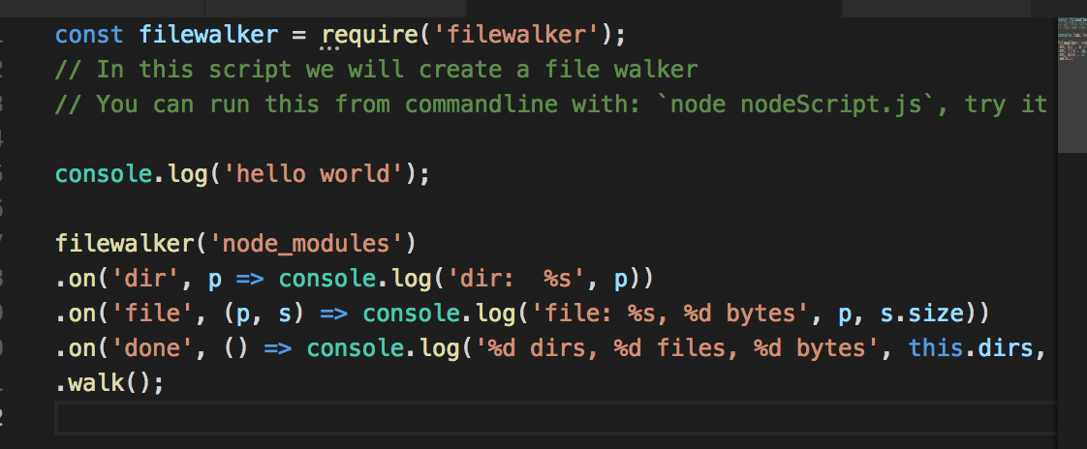
Notes:
filewalker('node_modules')
.on('dir', p => console.log('dir: %s', p))
.on('file', (p, s) => console.log('file: %s, %d bytes', p, s.size))
.on('done', () => console.log('%d dirs, %d files, %d bytes', this.dirs, this.files, this.bytes))
.walk();

Slide 118
Exercise create REST-API
https://www.codementor.io/wapjude/creating-a-simple-rest-api-with-expressjs-in-5min-bbtmk51mq

Slide 119
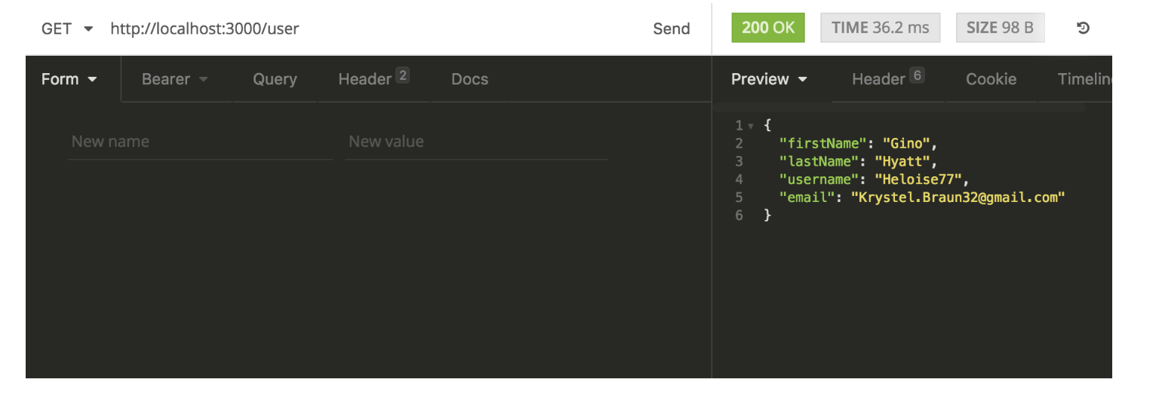

Slide 120
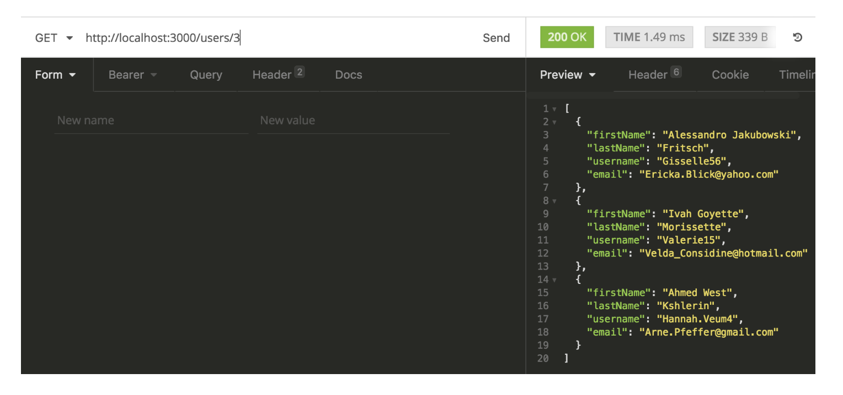

Slide 121
Building blocks
Node.js
ExpressJS: for REST API
body-parser
Faker: generate random user account details

Slide 122
Async Programming
Notes:
Voorbeeld Whatsapp. Async communcatie met messaging.
Why Axios?

Slide 123
What is HTTP?
HTTP works as a request-response protocol between a client and server.
Notes:
A web browser may be the client, and an application on a computer that hosts a web site may be the server.
Example: A client (browser) submits an HTTP request to the server; then the server returns a response to the client. The response contains status information about the request and may also contain the requested content.

Slide 124
HTTP Methods
GET
POST
PUT
HEAD
DELETE
PATCH
OPTIONS

Slide 125
GET Method
GET is used to request data from a specified resource over HTTP.

Slide 126
POST Method
POST is used to send data to a server to create/update a resource.

Slide 127
PUT is idempotent
https://developer.mozilla.org/en-US/docs/Glossary/Idempotent
Notes:
An idempotent method means that the result of a successful performed request is independent of the number of times it is executed.

Slide 128
HTTP Request Methods
https://www.w3schools.com/tags/ref_httpmethods.asp

Slide 129
Exercise

Slide 130
Sync vs Async Programming
Notes:
Voorbeeld Whatsapp. Async communcatie met messaging.
Why Axios?

Slide 131
Async Programming
By sending asynchronously, the JavaScript does not have to wait for the server response, but can instead:
execute other scripts while waiting for server response
deal with the response after the response is ready

Slide 132
Promise Syntax
Service.get()
.then(x => console.log(x)) → onsucces
.catch(error => console.log(error)) → onerror

Slide 133
Async with AXIOS
Promise based HTTP client for the browser

Slide 134
CORS
Cross-Origin Resource Sharing (CORS) is a technique for relaxing the same-origin policy, allowing Javascript on a web page to consume a REST API served from a different origin.

Slide 135
CORS

Slide 136
CORS
Notes:
This mechanism prevents attackers that plant scripts on various websites (eg. in ads displayed via Google Ads) to make an AJAX call to www.yourbank.com
and in case you were logged in making a transaction using *your* credentials.

Slide 137
Exercise Full stack 1 + 2
https://itnext.io/learn-how-full-stack-apps-work-by-building-a-simple-one-using-javascript-part-1-38e237694012
https://
Notes:
https://codeburst.io/build-a-weather-website-in-30-minutes-with-node-js-express-openweather-a317f904897b

Slide 138
configure the CORS
see: www.npmjs.com/package/cors

